Slide 1
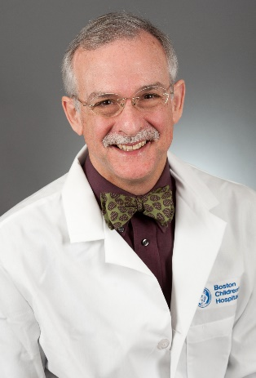
“Development of Acute Pediatric Stroke Program: Protection of the Child’s Brain in the Setting of Acute Stroke”
Michael Rivkin, MD
Associate Professor in Neurology, Harvard Medical School
Director, Intensive Neurology Care Service
Director, Cerebrovascular Disorders and Stroke Program
Sponsored by Children’s Center for Neurosciences Research
Friday, May 13th, 2016
12:00 PM - 1:00 PM
Egleston Classroom 5
With Videoconference to SR Sleep Lab
Please RSVP for lunch by noon on Thursday, May 12th at www.pedsresearch.org
(go to calendar and select the date and event).
If you have questions or need additional information, please contact Tracy Willoughby at twillo2@emory.edu.

