Slide 1
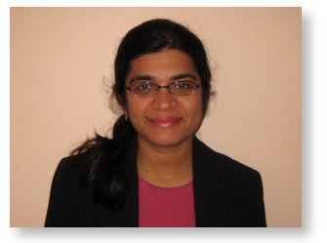
“Nanotherapeutic Approaches for Neonatal and Pediatric Brain Injury”
Sujatha Kannan, MD
Anesthesiology and Critical Care Medicine
Johns Hopkins University School of Medicine
Co-Director, Pediatric Neurocritical Care
Charlotte Bloomberg Children’s Center
Johns Hopkins University SOM
Sponsored by Children’s Center for Neurosciences Research
Friday, May 6th, 2016
12:00 PM - 1:00 PM
Egleston Classrooms 5-7
With Videoconference to SR Sleep Lab
Please RSVP for lunch by noon on Thursday, May 5th at www.pedsresearch.org
(go to calendar and select the date and event).
If you have questions or need additional information, please contact Tracy Willoughby at twillo2@emory.edu.

