Slide 1
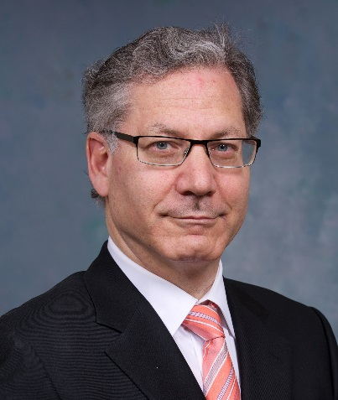
“Manipulating the Microbiome in IBD –
The Cause? The Solution?
Both? Neither?”
Charles N. Bernstein, MD
Distinguished Professor of Medicine
Director, University of Manitoba IBD Clinical and Research Centre
Bingham Chair in Gastroenterology
Sponsored by Children’s Center for Transplantation and Immune-mediated Disorders
Friday, December 1, 2017
12:00 PM - 1:00 PM
Egleston Classrooms 5-7
Please RSVP for lunch by noon on Thursday, November 30 at www.pedsresearch.org
(go to calendar and select the date and event).
If you have questions or need additional information, please contact Jennifer Villaseñor at jkenny2@emory.edu.

