Slide 1
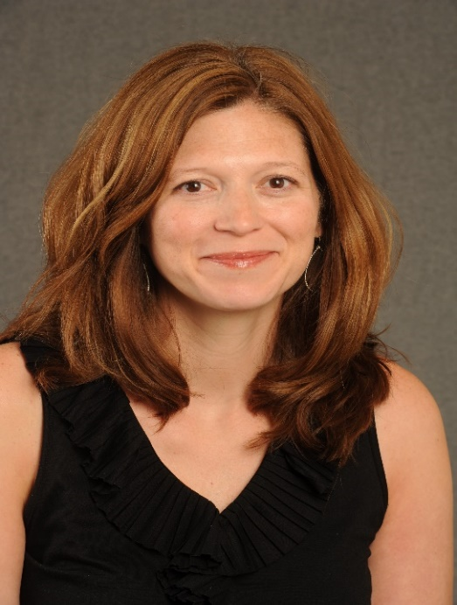
ARC
Aflac Research Conference
As part of the Aflac Visiting Lecture Series
Kristina Hardy, PhD
“Neurocognitive late effects in the 21st century: A prevention-based model of assessing and treating survivors of pediatric cancer”
Neuropsychology Division
Children’s National Health System
George Washington University School of Medicine
Date/Time:
Tuesday, February 27, 2018
12:30-1:30pm
Location:
EGL Room 5,6,7
Videoconferencing to Scottish Rite MOB 4th floor conference room
Lunch will be provided at EGL and Scottish Rite Locations.

