Slide 1
Research Billing PEARS October 9, 2020
Melissa Phomlavanh, BS, BS
Sr. Clinical Research Account Specialist
Office of Grants Accounting (OGA)
Corporate Finance

Slide 2
Research Billing Goals & Objectives
Understand how Research Billing works
Understand the importance and review of the Budget and Coverage Analysis/Prospective Reimbursement Analysis
Explain the process for submitting Research Patient Trackers
Explain the process for Patient Tracker corrections/revisions
Explain the review/approval process for Monthly Patient Care Invoicing

Slide 3
Research Billing: Epic Checklist
Coordinator must be listed as a User on the RSH record
Patient must be enrolled on the study in EPIC
Encounters(CRC) and orders(PI) must be linked to the study
Once the Research protocol has been created (ORA) and entered (OGA), the Timeline must be linked to the study
Training requests or refreshers should be directed to patrick.amos@choa.org

Slide 4
Research Billing: Budgets
Budgets are needed to verify which charges are research related and which are standard of care charges
Budgets provide the research prices needed to complete the patient care invoices
Budgets allow us to stay within the agreement amount with the government or the industry sponsor
Procedures listed on the patient tracker should be shown on the budget

Slide 5
Research Billing: Coverage Analysis
What is a Coverage Analysis?
A Coverage Analysis (CA) is required for all clinical trials in which tests, procedures, and interventions associated with a clinical trial are invoiced to the accountable financial party, such as the trial sponsor and/or third-party payor.
What is the result of a Coverage Analysis?
When the analysis is complete, the investigator receives a study-specific billing summary that lists all items and services to be provided as part of the clinical trial with notations of what should be billed to the research sponsor and what can be billed to Medicare. These billing grids are a valuable tool to ensure appropriate billing.

Slide 6
Research Billing: Coverage Analysis Cont’d
When a patient tracker is received, OGA will do the following:
Ensure that we have a Coverage Analysis (CA) saved to our study file
If a CA is not saved to a study file, OGA will reach out directly to the study team to provide one before moving any Research charges in Epic
OGA will verify that charges listed on the patient tracker are all included on the CA
OGA will move charges listed on the patient tracker based on the CA Billing Grid

Slide 7
Research Billing: Patient Trackers
Patient trackers to be submitted within 24 Hours of the visit
Email patient trackers to ogapatientcare@choa.org (not oga@choa.org)
A separate patient tracker should be provided for each Date of Service and/or Account Number
If changes or errors are found, a revised tracker should be submitted as soon as possible with the following updates:
1. Date of the submitted revision
2. Revision number
*Each time a revision is completed this section should be updated*

Slide 8
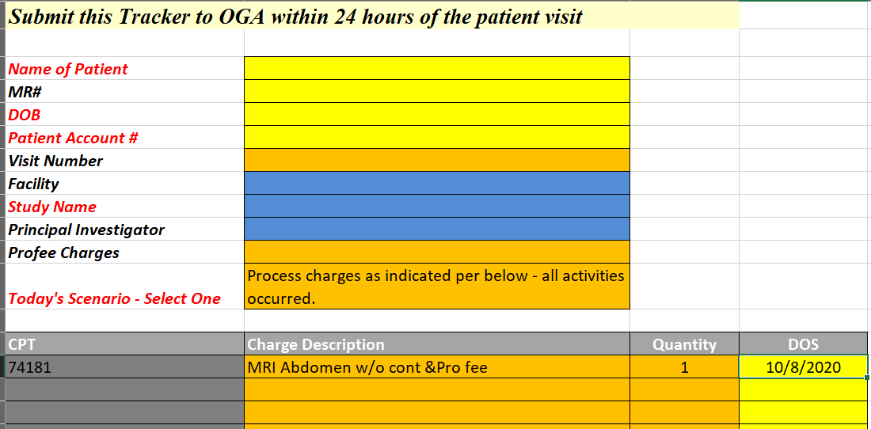
Patient Tracker Example

Slide 9
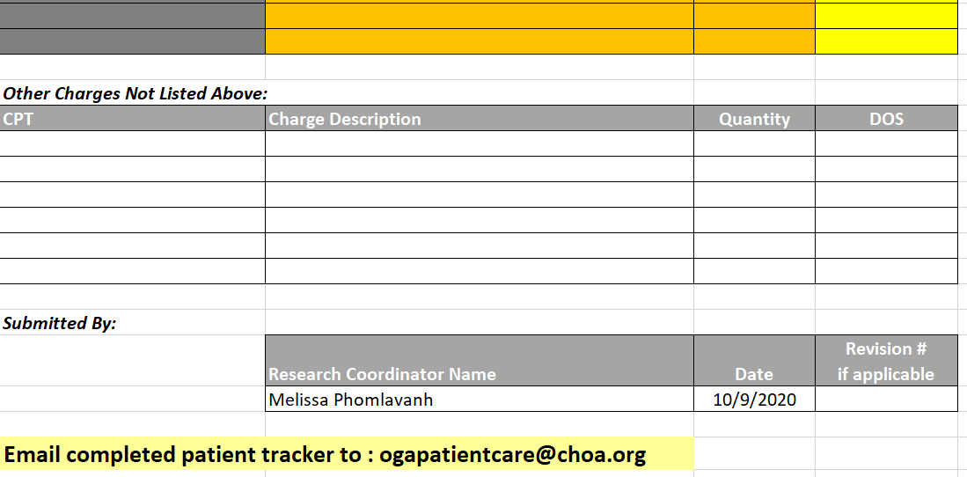
Patient Tracker Example

Slide 10
What if…
I forgot to enroll my patient in Epic
Enter immediately with a start date
I didn’t submit a patient tracker
Do so immediately with late tracker indicated in the subject line of the email
Procedures were not included on the patient tracker
Submit a revised tracker as soon as possible
Study budget doesn’t include charges repeatedly listed on the tracker
A budget revision may be needed and if possible, requested

Slide 11
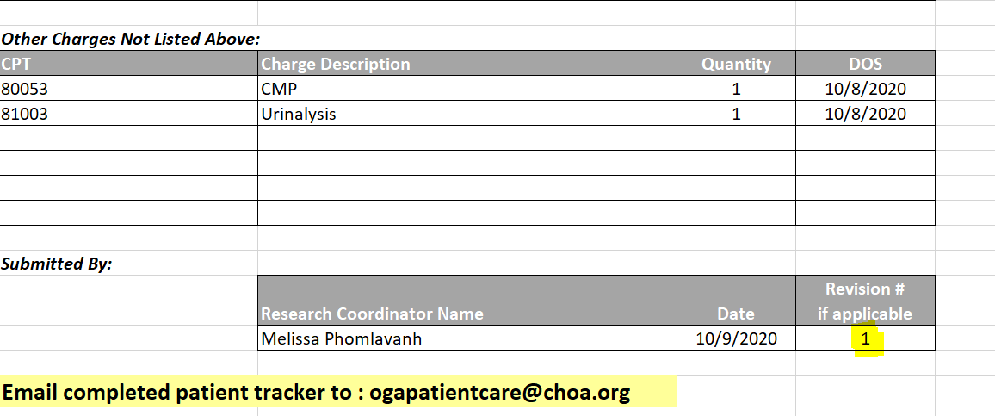
Patient Tracker Revision Example

Slide 12
How to Prevent Research Patients from getting Billed
Enroll your patient on the study in Epic
Forward the patient tracker to ogapatientcare@choa.org within 24 Hours
Ensure that accurate information is provided:
Study Name
Patient name
DOS
Account #
CPT codes
Verify that the procedures performed posted to the patient account

Slide 13
What to do if a Patient is Incorrectly Billed?
Email the following to ogapatientcare@choa.org
A copy of the patient’s bill
A copy of the corresponding patient tracker
Let the patient know that the account is being reviewed
Depending on the OGA update, a revised patient tracker to include any omitted procedures may be needed
It is important to note that OGA is not permitted to communicate directly with Patients/Parents. All communication regarding billing must be done through the Study Team

Slide 14
Research Billing: Monthly Patient Care Invoicing
At the end of each month, ALL submitted Patient Trackers will be reconciled and consolidated into a Patient Care Study Invoice created by OGA. OGA will send invoice(s) to the appropriate study coordinator for review, approval and signature:
CRCs should verify that the dates of service, patient name, CPT Codes and activity number shown on the invoice are correct
Only approvals by signature/scan are accepted
Approved invoice(s) should be submitted by the deadline specified by OGA
A follow up email will go out within 3 business days if approval has not been received by specified the deadline
Quick invoice approval turnaround time is critical for meeting the Corporate Finance month-end close deadline. If invoices are not submitted on time, they will not be recorded until the following month

Slide 15
Who can help me?
Office of Grants Accounting: Epic Research Billing Contacts
Melissa Phomlavanh Sr. Clinical Research Account Specialist E: Melissa.Phomlavanh@choa.org P: 404-785-7344 | Kesia Hudson Sr. Clinical Research Account Specialist E: Kesia.Hudson@choa.org P: 404-785-6108
Dietre May Sr. Clinical Research Account Specialist E: Dietre.May@choa.org P: 404-785-7501 | Jamilla Sabree Clinical Research Account Specialist E: Jamilla.Sabree@choa.org P: 404-785-7896

Slide 16
Questions?

