Slide 1
EMITS-Interpretation Services Process
A guide on identifying and providing interpretation services for Deaf, Hard of Hearing and Limited English Proficient Patients their families and companions.

Slide 2
Compliance
Fundamental Compliance of ACA Section 1557
  Effective Communication with Persons with Disabilities
Section 1557 requires provision of effective communication for individuals with disabilities, Auxiliary aids and services to individuals with impaired sensory, manual, or speaking skills.
  Effective communication with Persons with Limited English Proficiency (“LEP”)
EXCEPTION: Section 1557 makes exceptions for the use of friends family members as interpreters of adult friends or family in emergency situations.

Slide 3
EHC and IRB Policies related to Limited English Proficient persons.
http://www.irb.emory.edu/documents/PoliciesandProcedures.pdf
http://irb.emory.edu/forms/consent_toolkit/shortforms.html
There are several Emory Healthcare policies related to Deaf, non English speaking and Limited English proficient persons.

Slide 4
Services for hospitals and hospital based clinics that EMITS supports.
Qualified Interpreters:
EHC staff interpreters or agency contractors..
Telephonic services:
These services provide an interpreter who is accessed over a telephone line.
Video Remote Interpreting Services:-iPads
These services are provided by using an iPad to connect with the vendor via video.
Qualified bilingual/multilingual staff and Dual Role medical Interpreter
An employee (staff or provider) who has been qualified as bilingual or qualified as a dual role medical
Translation of documents
It is also required by law to provide patients translation of vital documents in patient’s preferred language. interpreter@emoryhealthcare.org

Slide 5
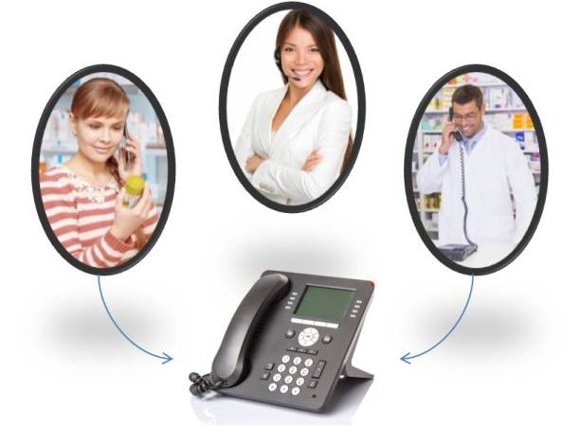
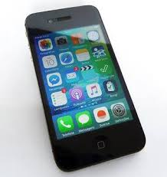

Services Available – via EMITS : 404-727-3648
  Over the Phone Interpretation 24/7:
    Blue Phones Corded or Cordless
    NEW: From Desk Phones &Cell Phones:
          Option 2: Spanish
          Option 4: Vietnamese
CyraCom – Provides Over the Phone for Interpretations for over 200 Languages.
EMITS : 404-727-3648

Slide 6
Requests for an Interpreter: Onsite or via Zoom for Telehealth :
Spanish & Vietnamese Staff Interpreters (Depending on Availability).
Other Languages: Agencies in person interpreters or CyraCom over the phone.
Date of Service Language Time Duration - expected time needed from start to finish Name of patient Medical Record Number Location - please include full address | Department Number/ Billing Code/Smart Key Number Name of Provider Contact/Requester Full Name Requester Phone Number (to reach requester directly) Telehealth – Provide Zoom details via email
EHC Intranet » Departments & Groups » Emory Medical Interpretation & Translation Services» Scroll Down to Tiles » Select Location Tile » Future Requests
  EMITS – 404-727-3648
  interpreter@emoryhealthcare.org
  Monday & Tuesday: 5:30 am – 5pm
  Wednesday – Friday: 5:30 pm – 8pm
  Saturday & Sunday: 8:30am – 5pm

Slide 7
Interpreter: The qualifications- Consents and signing as a witness.
All interpreters should be qualified. Upon request we will provide copy of documents.
Short consents will be sight translated-
Long forms will not be sight translated, in this case the provider will need to explain the information to the patient and the interpreter will render this information.
Qualified medical interpreters are allowed and able to sign as a witness for consents.
Interpreters are not able to sign for patients.

Slide 8
X - Waivers of Interpretation Services
Use when LEP or deaf patient waives the use of EHC’s qualified Interpretation services.
Even if waiver has been signed, you have the right to use qualified interpreter for effective communication.
Waiver of Interpretation Services has been translated into 10 Different Languages.
  Waiver document must be labeled and placed into patients paper chart or
  scanned under “Other” Consents in Patients Electronic Medical Record.
  EMITS – 404-727-3648 – Opt 1

Slide 9
XI. EMITS Website
EHC Intranet>Departments & Groups>Administrative Departments>Emory Medical Interpretation and Translation Services>Select Tile Location
http://www.ourehc.org/departments/emits/index.html
XII. Tools & Information for LEP Patient’s Interactions:
Tips on working with interpreters.
Picture and letter boards.
Document Translation - translation@emoryhealthcare.org
The Waiver of Interpretation Services – English & Spanish and how and when to use it.
Bilingual Certification Guidelines and links.

