Slide 1
For the Love of Consenting
PEARLS Lunch Series
Ashley Guven, RN & Kaitlin Jones, BSN, RN

Slide 2
Informed Consent
“A process in which health providers educate a patient about the risks, benefits, and alternatives of a given procedure or intervention.”
Requirements:
Patient/ Family Competency
Voluntary Participation
Verbalized Understanding
Notes:
https://www.ncbi.nlm.nih.gov/books/NBK430827/

Slide 3
Why Do We Consent?
Legal and Ethical Obligation
Henrietta Lacks
Died at 31 from Cervical Cancer
Cell Tissue Harvested
No consent obtained
Johns Hopkins – 1951
Permission was not required
Was not standard practice
Notes:
https://www.bing.com/images/search?view=detailV2&id=46C08B0FF6F4820FA7D18D31AD1895713861059A&thid=OIP.veiS_9D9L8zNY0q5E_-DMQAAAA&mediaurl=https%3A%2F%2Fupload.wikimedia.org%2Fwikipedia%2Fen%2Fd%2Fd7%2FHenrietta_Lacks_%25281920-1951%2529.jpg&exph=362&expw=250&q=henrietta+lacks&selectedindex=1&ajaxhist=0&vt=0&eim=1,2,6&ccid=veiS%2F9D9&simid=608048900507239471&sim=11

Slide 4
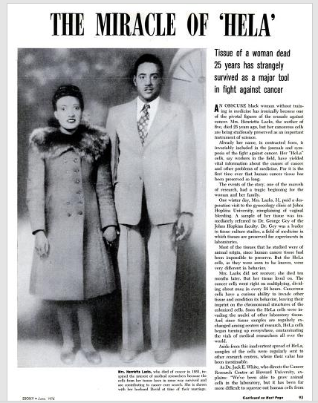
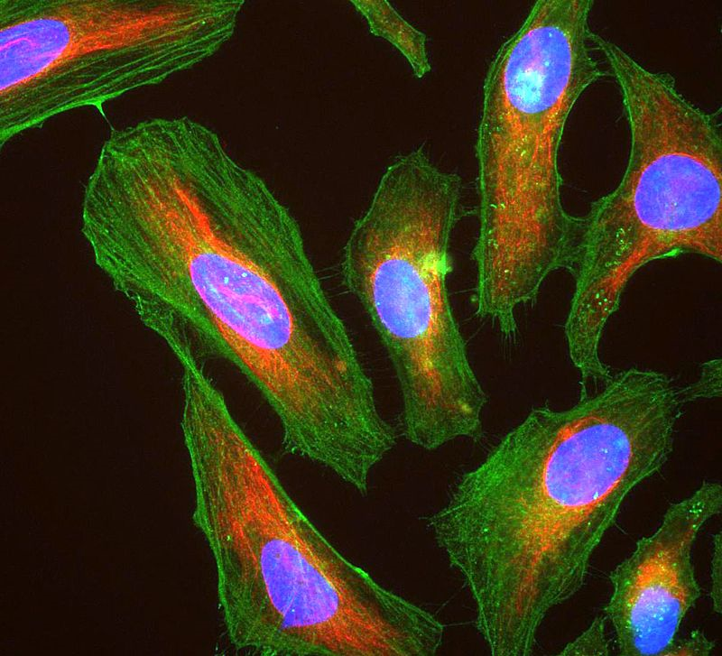
HeLa Cell Line
Worldwide Research:
Cancer
AIDS
Radiation effects
Gene Mapping
Notes:
https://en.wikipedia.org/wiki/HeLa#/media/File:HeLa_cells_stained_with_antibody_to_actin_(green)_,_vimentin_(red)_and_DNA_(blue).jpg
We can still do good research and make medical advancements

Slide 5
Consent Conversation
Topics to Include:
Nature of the procedure
Risks and benefits of participating
Reasonable alternatives
Risks and benefits of the alternative
Assessment of patient’s understanding

Slide 6
Notes:
https://www.bing.com/images/search?view=detailV2&id=004D40AF69E2B33A5BB250C4154A4EF2A8492101&thid=OIP.aGq846cifJt7n-84r8qmkgHaDf&exph=400&expw=850&q=george+bernard+shaw+quote+on+communication&selectedindex=0&vt=0

Slide 7
Notes:
https://www.bing.com/images/search?view=detailV2&id=92BC883B60C1735B108098D29E80C8BF1504212B&thid=OIP.AXzhtmdD51Wgv49Yi_nwzgHaGL&mediaurl=http%3A%2F%2Fblogs.plos.org%2Fabsolutely-maybe%2Ffiles%2F2016%2F11%2FStudy-result-sharing.jpg&exph=1344&expw=1610&q=research+consenting+cartoons&selectedindex=3&ajaxhist=0&vt=0&eim=1,2,6&ccid=AXzhtmdD&simid=608045039338523374&sim=11

Slide 8
What Went Wrong?
Used words that were hard to understand
Omitted important study information
Coercion
Notes:
Coercion examples could be emphasizing monetary compensation and giving them your opinion in favor of enrolling in the trial. i.e.- “If this were my child I would absolutely enroll them in this trial”

Slide 9
Barriers to Good Consenting
Language barriers
Sensitive situations
Mistrust in Medical Systems/Professionals
Protocol Time Windows
Equipoise
Notes:
-Always use an interpreter for consenting families if not English speaking or completely fluent in English.
-Sensitive situations, ie- Severe TBI cases, PICU cases (Kaitlin elaborate) and domestic instability.
- People that have had a bad inpatient experience, either at CHOA, or elsewhere.

Slide 10
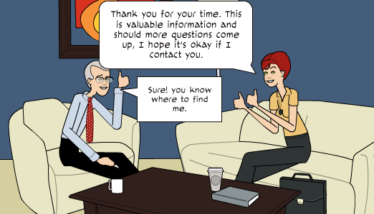
Notes:
https://www.bing.com/images/search?view=detailV2&id=5B2F04BB09D12289C22FDE73184D933FB6AC4B0F&thid=OIP.vLY4CbRQkaopvY8pOi1TiwHaEQ&exph=300&expw=522&q=cartoon+consenting&selectedindex=103&ajaxhist=0&vt=0&eim=1,2,6

Slide 11
Examples of Good Consenting
Clear and concise explanation
Pause for questions
Patient teach-back
Interpreting Services

Slide 12
The Patient’s Role in Consenting
They must be their own advocate
They should clarify anything that is unclear
They should ask questions
Notes:
Patient advocacy- The patient needs to ask questions when they need additional clarification. However it is our responsibility to ensure that they understand, even if they don’t ask to clarify.
-Give example of TBI consents versus SAXOPHONE consents?
Sometimes they will not, whether it be the stress of the situation, patient acuity or the parent/ patient level of comprehension.

Slide 13
Questions?

