Slide 1
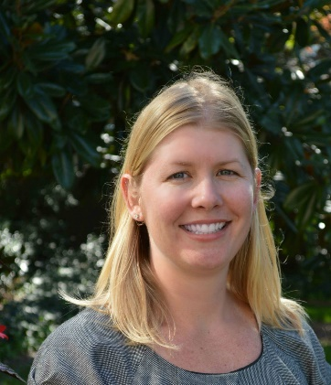
PEARS: Pediatric Education Research Series
Auditing, Monitoring, Compliance and Good Document Practice
Presenter: Stephanie deRijke, Senior Director, Clinical Trials Audit and Compliance (Emory)
Friday, January 8, 2021 at 12:00pm
Zoom Streaming Only

